Slide 1

Evaluation of the Performance of Isolation Forests for Anomaly Detection
- Barath Raj Asokan

Slide 2

TABLE OF CONTENTS
01.
INTRODUCTION
02.
ANOMALY DETECTION
03.
ISOLATION FORESTS
04.
CONCLUSION

Slide 3
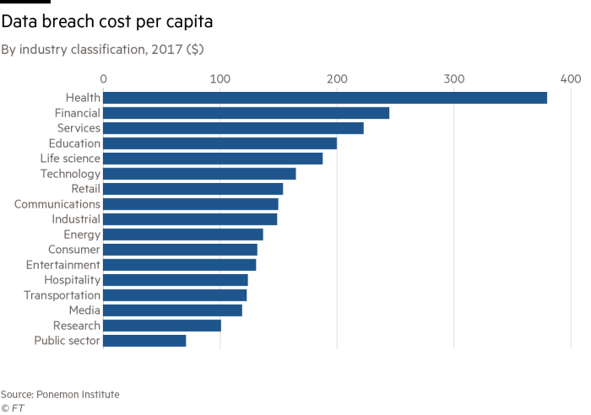
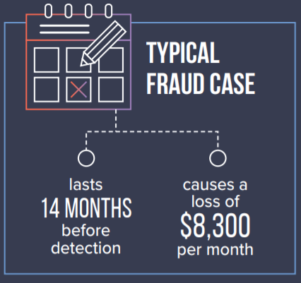
1. INTRODUCTION
Frauds are extremely detrimental and cost intensive.
Threat detection/Anomaly Detection is at its peak in cybersecurity protocols.
Major Sectors – Healthcare, Finance and IT Service.
“Fraud costs are increasing at a faster rate than fraud risk management spend. A radical rethink is urgently required”
- David Hicks, Global Forensic Leader KPMG

Slide 4
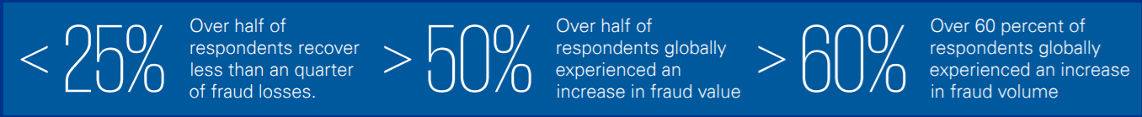

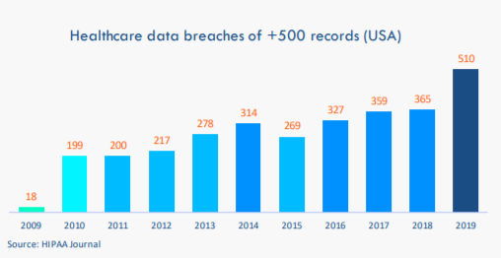
- Source: Global Banking Fraud Survey, KPMG International 2019
“The Association of Certified Fraud Examiners recently revealed that the median loss from a single case occupational fraud throughout the world amounts to $150,000.”
— Keith Bothma, Sr.Account Manager Microsoft
Notes:
As per the survey by KPMG…
Small companies are not equipped to handle cyber attacks
Something to be done to avoid even bigger losses

Slide 5
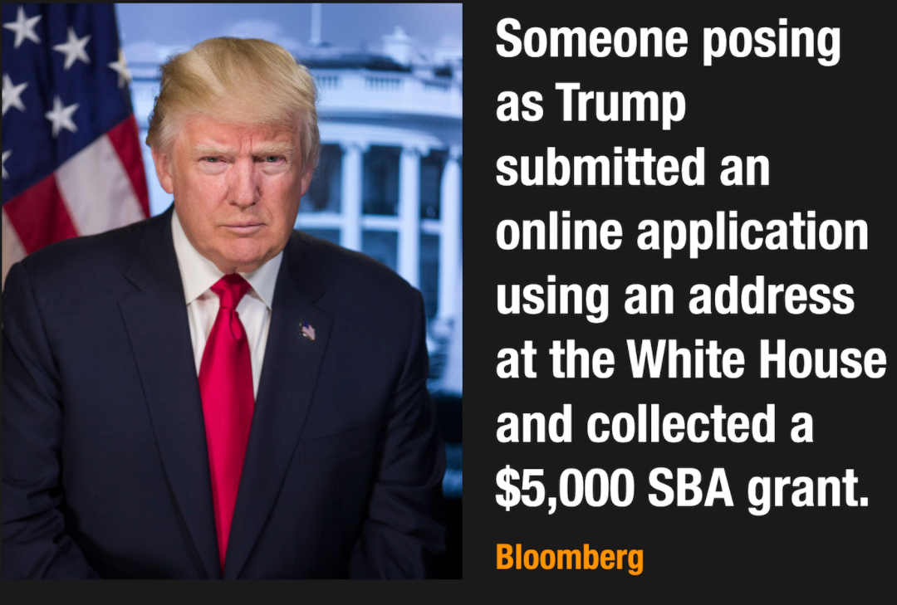
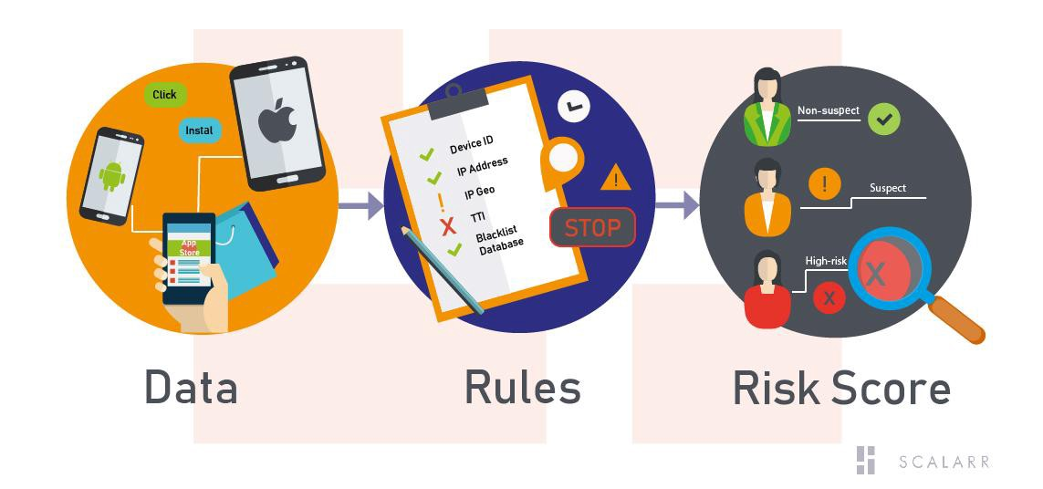
CURRENT SYSTEM - RULES BASED SYSTEM
Most banks employ Rule-based Systems with manual evaluation for detecting fraud
Rules-based systems rely on pre-programmed rules to identify changes in behavior or predict outcomes.
Time Intensive, requires manual work and supervision
Identifies obvious fraud patterns
Less scalable and becomes more expensive as data set increases
“Fraud techniques are improving with new technologies. Rules-based logic (time-intensive, manual supervision) model is now not enough.”
- Forbes, Louis Columbus
Notes:
- Rules based system offers mostly detection and not prevention
- New patterns not detected

Slide 6


2. ANOMALY DETECTION
How to Detect/Prevent Frauds ?
Anomaly detection algorithms learn from fraudulent transactions to identify/isolate patterns and classify fraudulent transactions
“The ongoing digitalization of the banking sector is certainly creating new fraud risks. But it is also spawning some amazing new solutions and opportunities for those charged with protecting the customers and assets. Banks should prioritize fraud prevention with digital strategies”
- Judd Caplain, Global head of Banking and Capital Markets KPMG
Notes:
As per the survey by KPMG…
Small companies are not equipped to handle cyber attacks
Something to be done to avoid even bigger losses

Slide 7

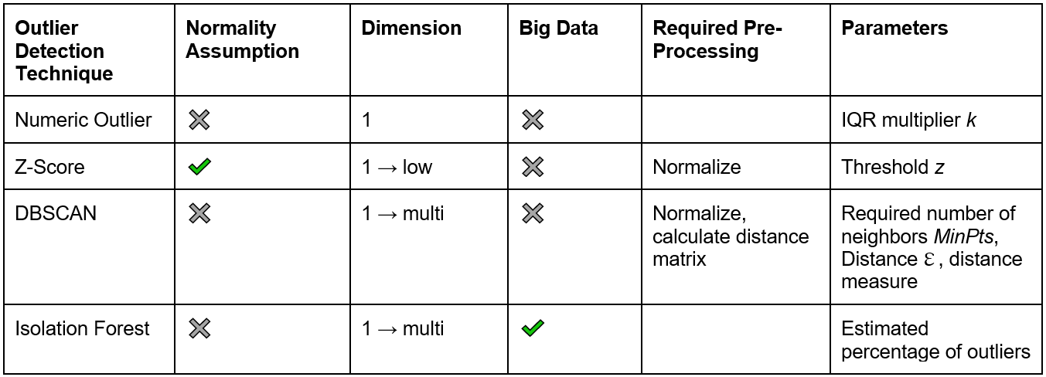
Some Popular Anomaly Detection Algorithms
“Combining supervised and unsupervised ML is the foundation of fraud detection”
- Forbes, Louis Columbus

Slide 8
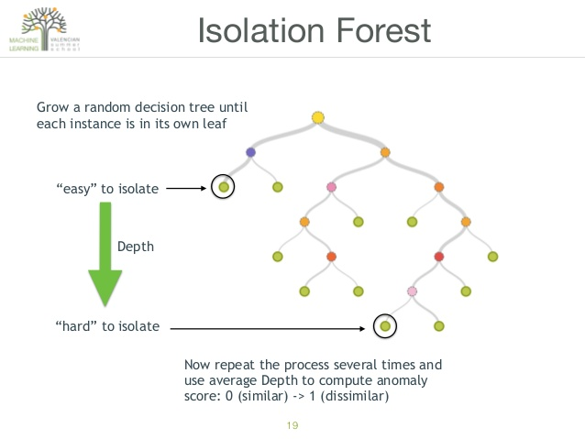

3. ISOLATION FORESTS

Slide 9


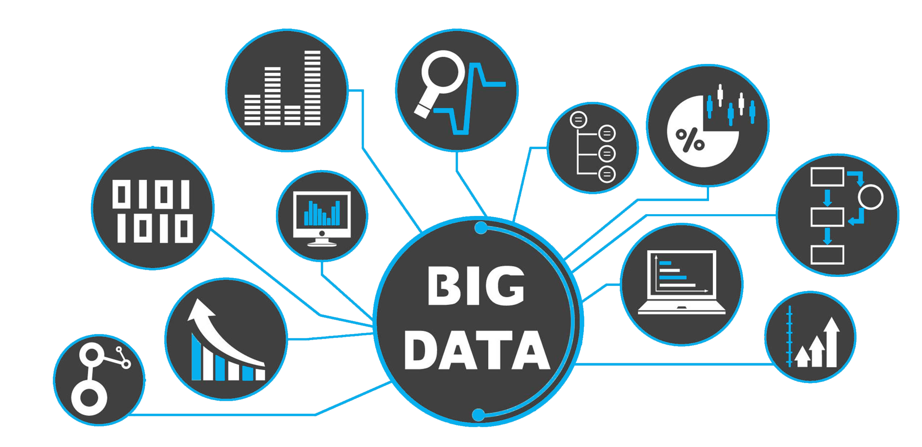




PROS
CONS
Highly Scalable – Big Data Applications
High Proportion of Anomalies in the data set
Limited Preprocessing
Business Knowledge is Important to filter out Anomalies – Application Specific
Time Efficient – Sub Sampling
Multi Dimensional

Slide 10
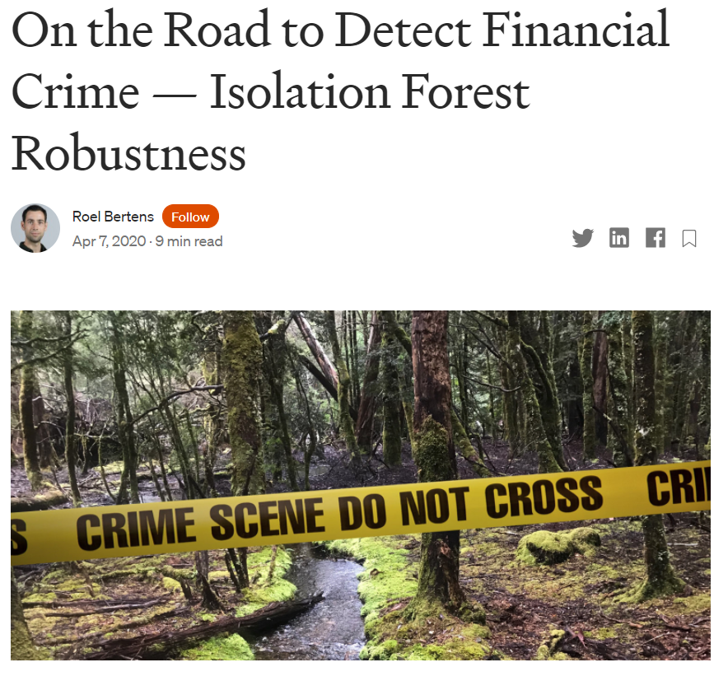
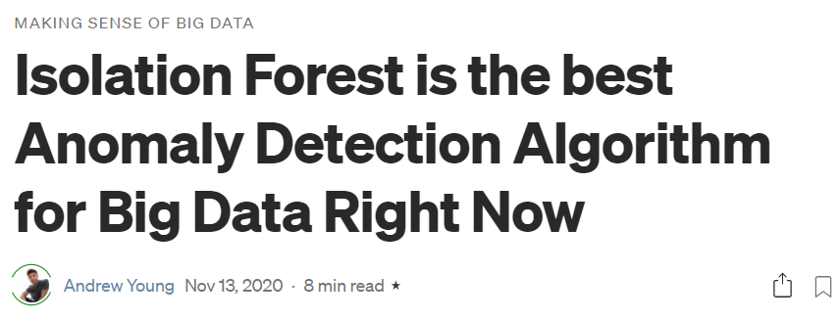
Some Real-Life Use Cases
- Andrew, Data Scientist, Google Inc.
- Roel, Data Scientist ING Brussels.

Slide 11


4. CONCLUSION
Isolation Forests are Robust and Fast.
Has the potential of upscaling by adding Hyper parameters.
High Application compatibility

Slide 12

THANK YOU!

